Slide 1
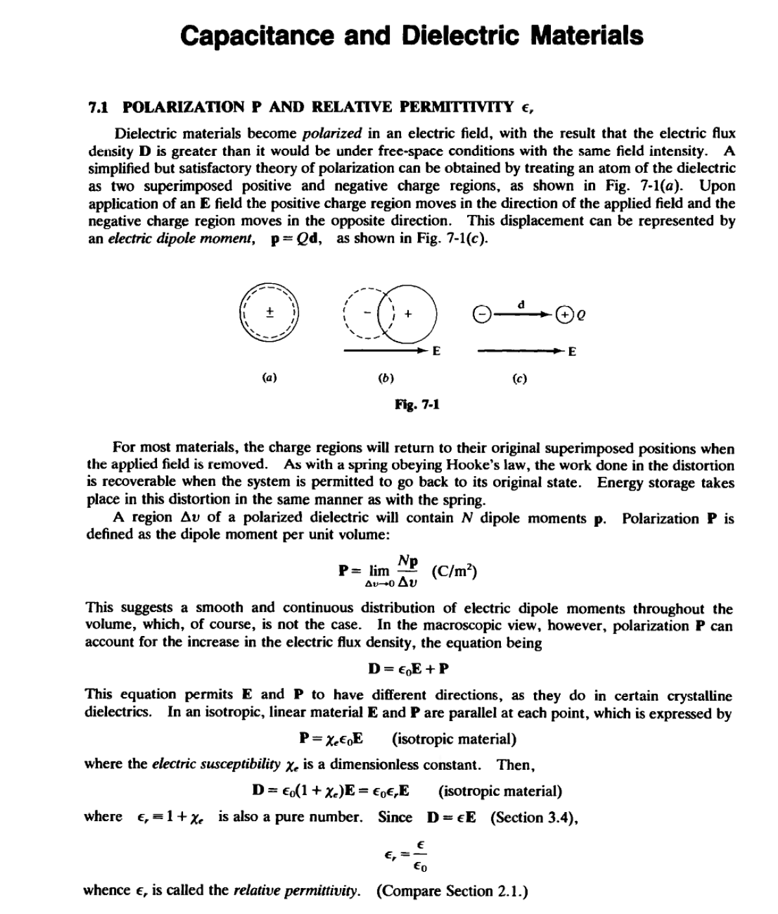
LECTURE SEVEN

Slide 2
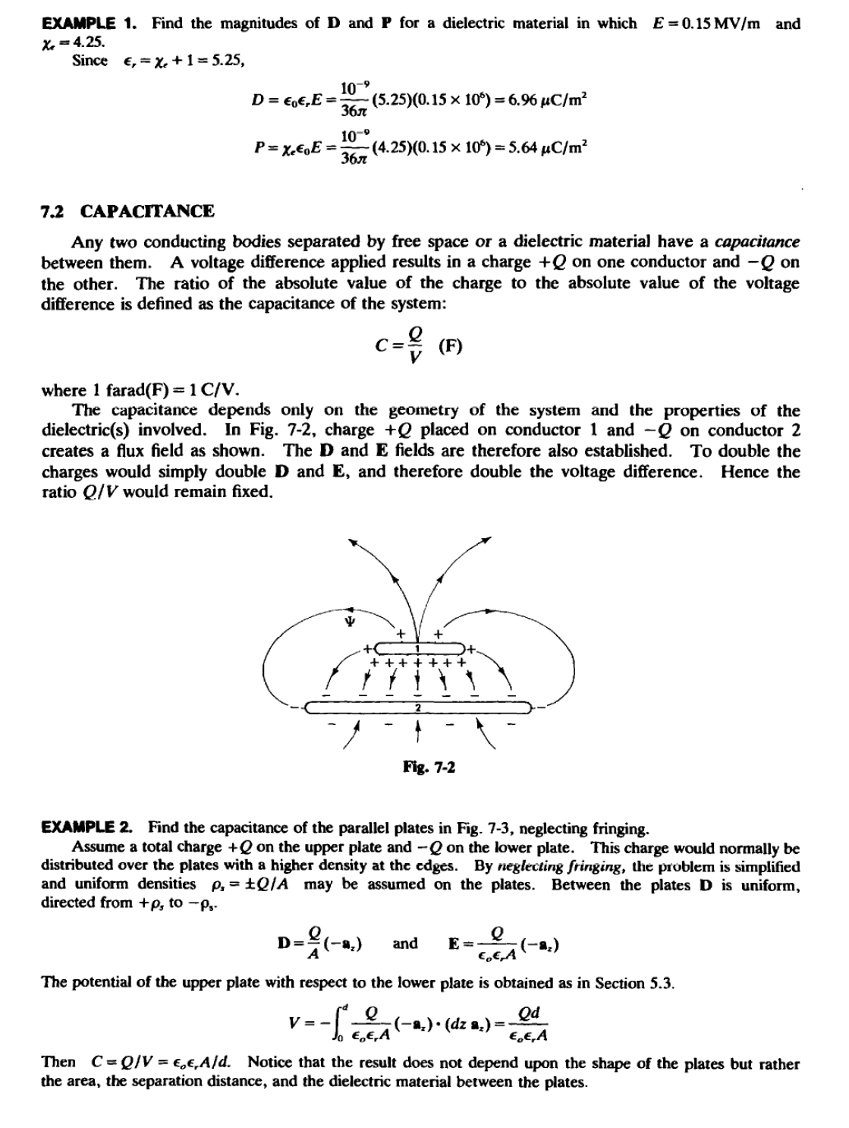
LECTURE SEVEN

Slide 3
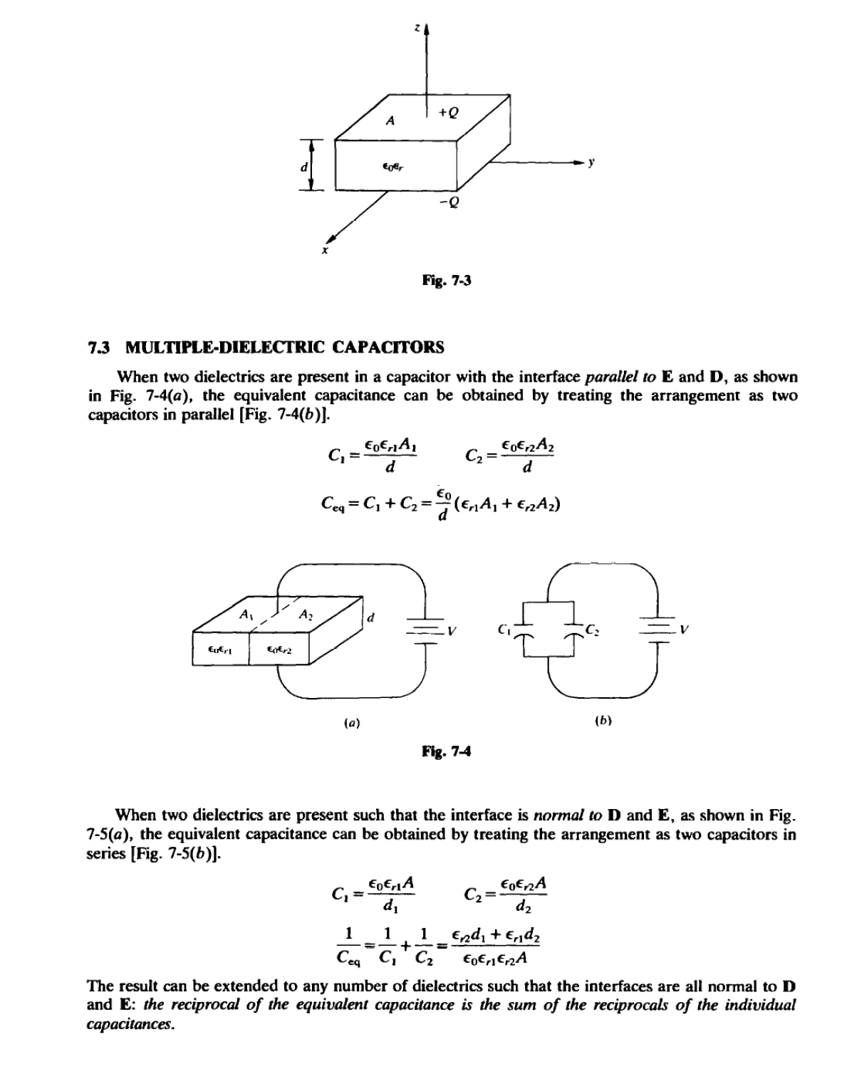
LECTURE SEVEN

Slide 4
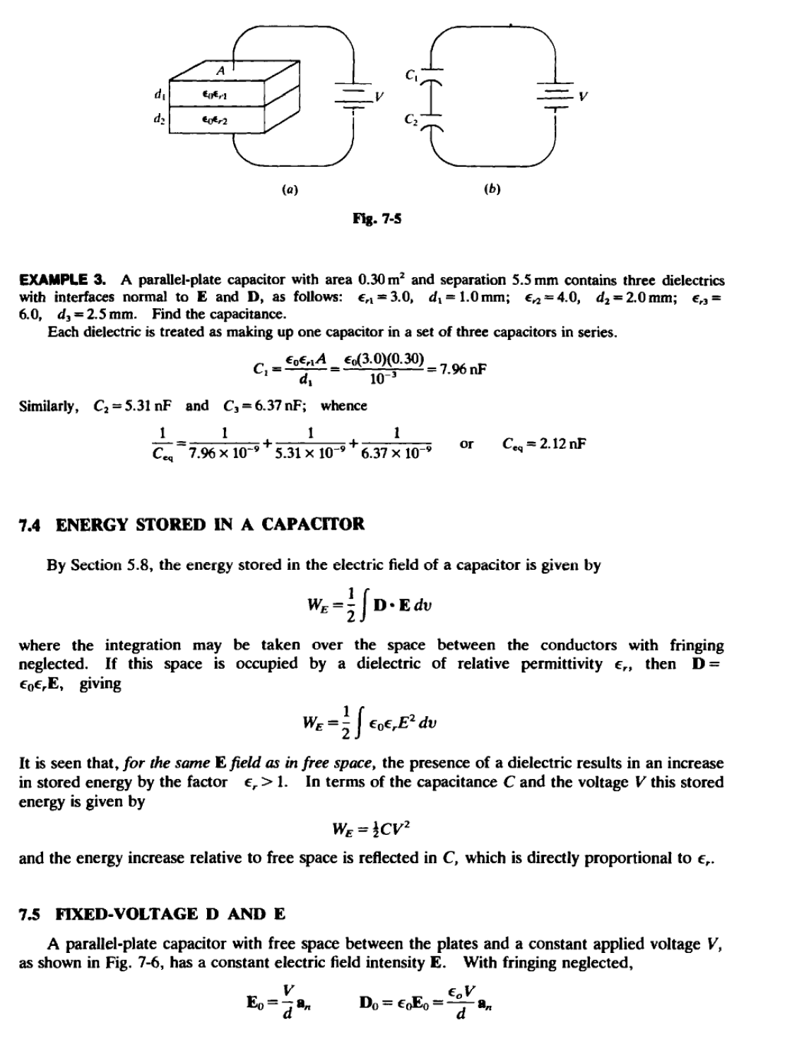
LECTURE SEVEN

Slide 5
LECTURE SEVEN

Slide 6
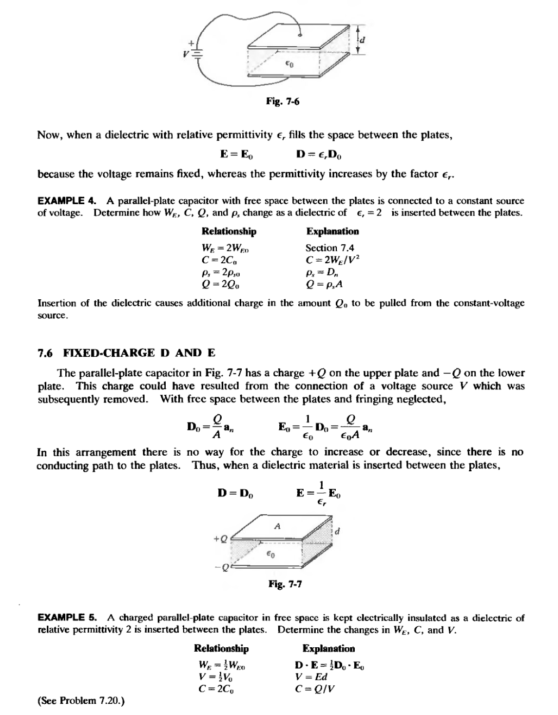
LECTURE SEVEN

